Slide 1
Project overview & Data
GOAL
To examine London Borough dataset and find out average price hike ratio with in 20 years.

Slide 2
Sourcing & loading
we found the data set from London Government website and imported the data in a Excel Format.

Slide 3
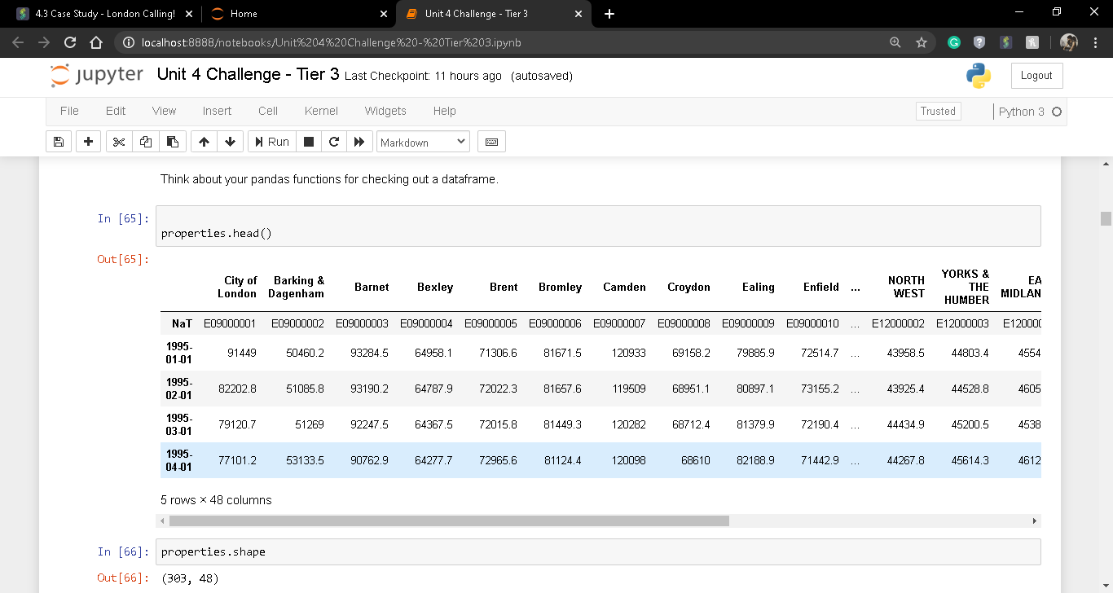
The primary dataset looks like this-

Slide 4
Problems in Dataset
We can observe that the dataset is in a unshaped manner.
If we observe the Boroughs of this data set there are some irrelevant
names are present(example – London, England etc).
Also there are some NaN values present we need to remove them too(example – unnamed:33,Unnamed:46 etc).
So we need to apply some cleaning to get a better view of the dataset and overcome the problems.

Slide 5
Solutions
Transpose the data set.
Reset the index of the dataset.
Melting the dataset by id and borough names.
Removing NaN values from the dataset.
Keeping only unique Boroughs

Slide 6
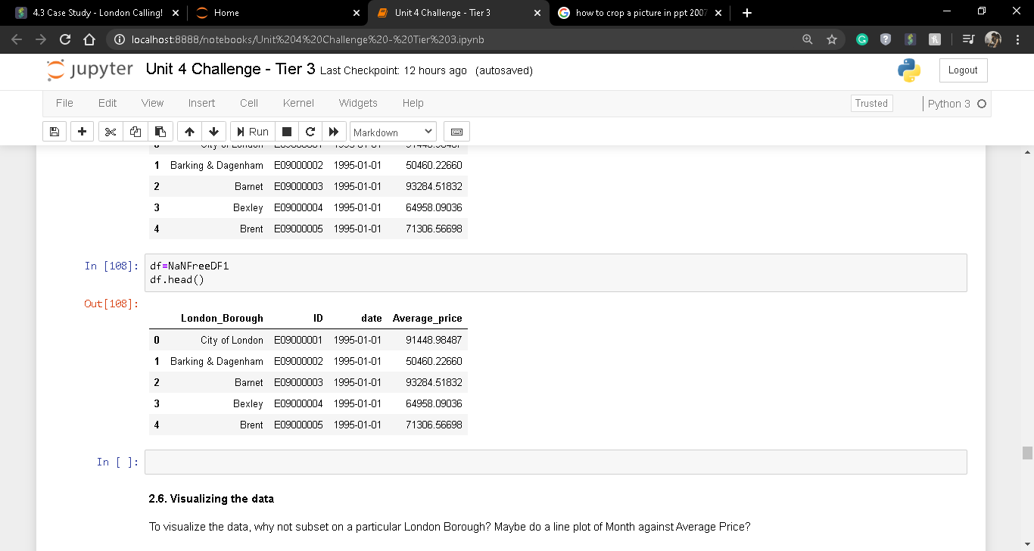
The transformed dataset looks like this

Slide 7
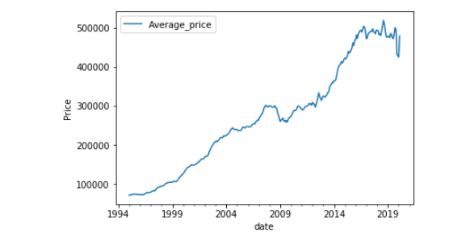
Visualization of average price hike over the years(Brenet)

Slide 8
Observation
As we can see Brenet average price is increased with the years.
Now to get the ratio increased of average price of the cities we nee to extract years from the date based on that we need to get the ratio(1998-2018).

Slide 9
To get the ratio of average price hike in 20 year spam(1998 to 2018) we need to extract average price of 1998 and 2018 of Boroughs and divide it.

Slide 10
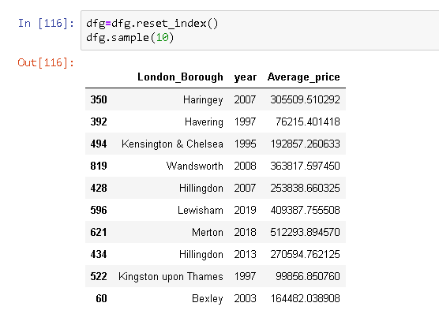
Dataset with Borogh names,year and Price

Slide 11
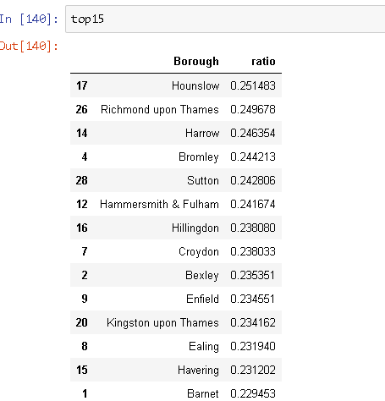
Calculation of price increase ratio(1998-2018)

Slide 12
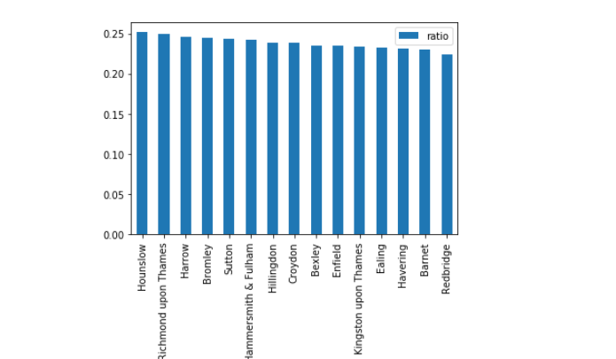
With visualization we can see the top ratio increased Boroughs

Slide 13
Conclusion & Finding
After exploring the data set and comparing the price of 1998 and 2018 we can come to a conclusion that the average price of London Borough has increased over the years and the highest increase is observed in Hounslow with 25% if price increment.
By digging deeper we can see that the top 15 Borough has gone through price increment of minimum 20% or higher.

Slide 14
Thank YOU

